Slide 1
Cool Kicks
Made by - Sarthak Dixit(171500293)
Shubham Yadav(171500336)
Sagar Gupta(171500278)

Slide 2
Contents
Objective
Key Features
System Requirements
Languages Used
Implementation
Conclusion

Slide 3
Objective
This online shopping site project is a general project which helps many people who want to sell their product online. Each business people can customize this program according to their requirements. This software also helps customer to find different products, their features, and new updates easily. It is designed such a way that one can view all the updates of the product from any place through online. The purpose of the system is to develop a simple Online Shopping Website and implement it, which later will be used for a web-based application.

Slide 4
Key Features
1. The system requires very fewer time factors as compared to manual system.
2. The system will provide fast and efficient automated environment instead of slow and error prone manual system.
3. The system will have GUI interface and very less user training is required to learn it.

Slide 5
System Requirements
Hardware Requirements :
1. A PC minimum of 2GB RAM
2. I3 Based Computer or Higher
Software Requirements :
1.One Text editor (VCS, Sublime, Brackets etc.)
2. XAMP Server
3. Chrome

Slide 6
Languages used
HTML
Hypertext Mark-up Language (HTML) is the standard mark up language for documents designed to be displayed in a web browser.
CSS
Cascading Style Sheets (CSS) is a style sheet language used for describing the presentation of a document written in a mark up language like HTML.
Boot Strap 4 Bootstrap is a powerful front-end framework for faster and easier web development. It includes HTML and CSS based design templates.
PHP Hypertext Pre-processor (or simply PHP) is a general-purpose programming language originally designed for web development.

Slide 7
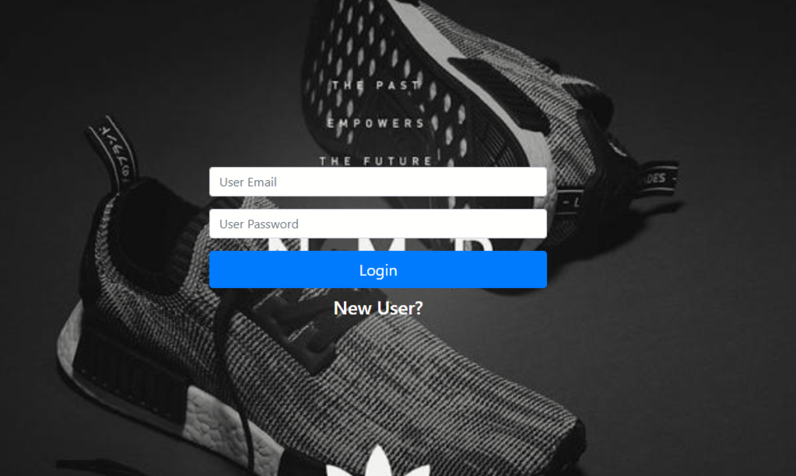
Login Page

Slide 8
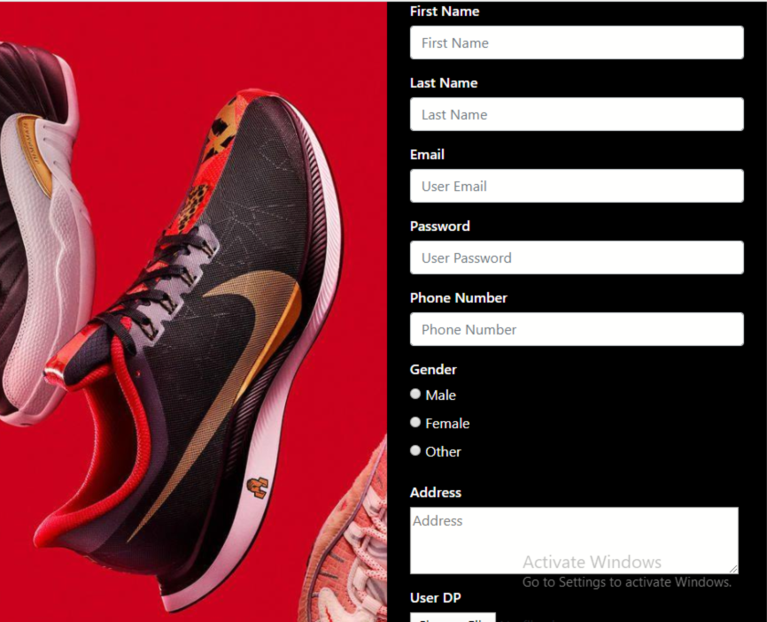
Signup Page

Slide 9
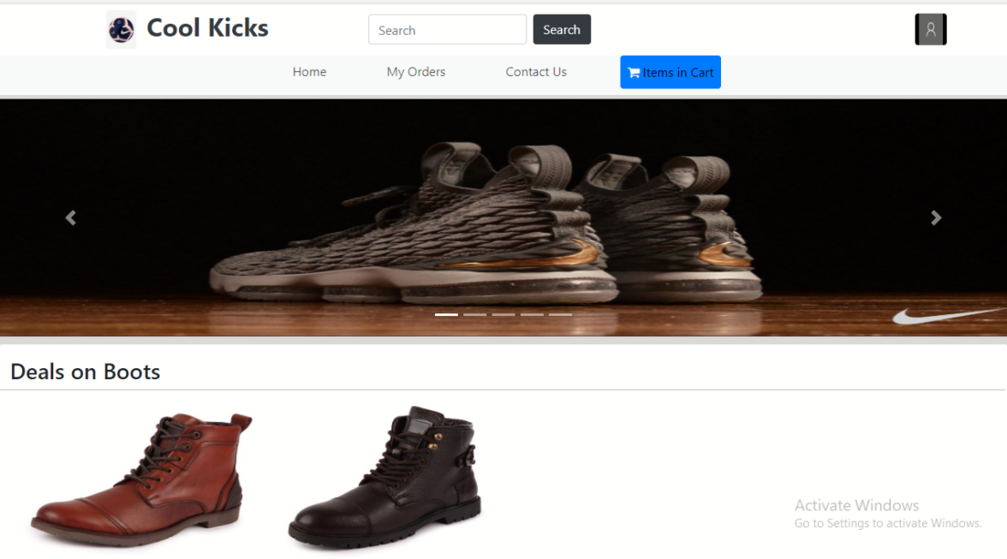
Main Page

Slide 10
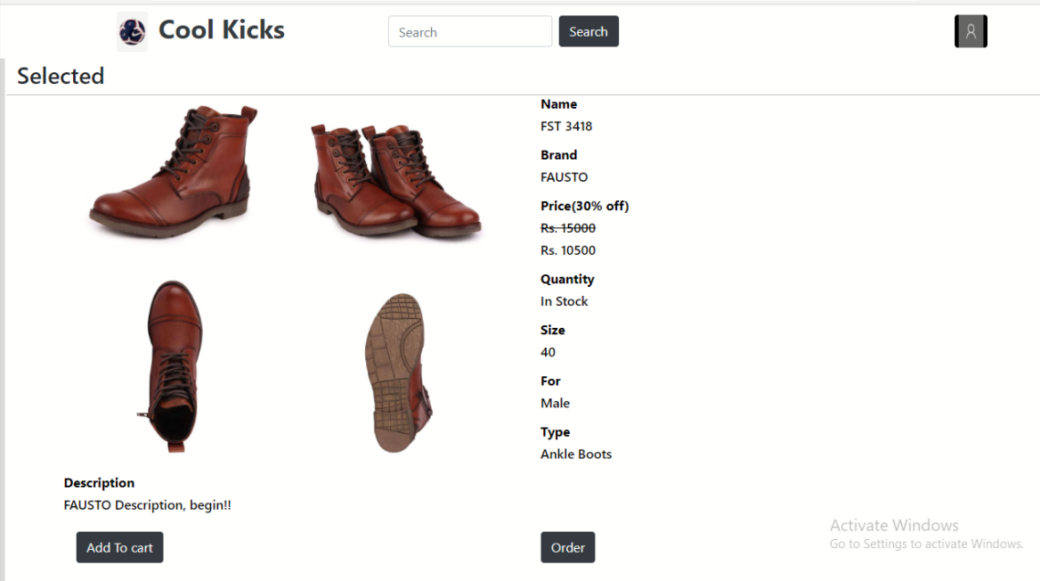
Products Page

Slide 11
Conclusion
After the completion of project, customer can view the all products of our Shopping Website but cannot order any item without registration. New customer can create a new account by going on sign up page. After registration, he can login and now can add any item in any quantity in the shopping cart. . Even he can delete any item or can clear overall cart items in one go by clicking the option clear cart. He can place the order only through cash on delivery mode. After placing the order he can view the summary with an order id which is the table number of that particular customer.

Slide 12
Bibliography
https://getbootstrap.com/
https://dev.mysql.com/doc/
https://www.w3schools.com/bootstrap/bootstrap_ver.asp
https://www.javatpoint.com/phpmyadmin

Slide 13
THANK YOU

